Slide 1

Multicore Programming (CS 535) Project Presentation
Students: Mustafa Ghanim and Cengiz Emre Dedeağaç
Instructor: Asst. Prof. İsmail Aktürk
Project Title:
“A Fast Implementation of Adaptive Median Filter Using Multithreading”
‹#›/22

Slide 2
Project Motivation
2D Median filter is widely used in image processing applications
Adaptive median filter (AMF) enhances the noisy image quality better than the local median filter (LMF)
AMF is more complex and does not have a direct implementation in OpenCV library
Fast operations on video (image) frames are critical for real-time applications
‹#›/22

Slide 3
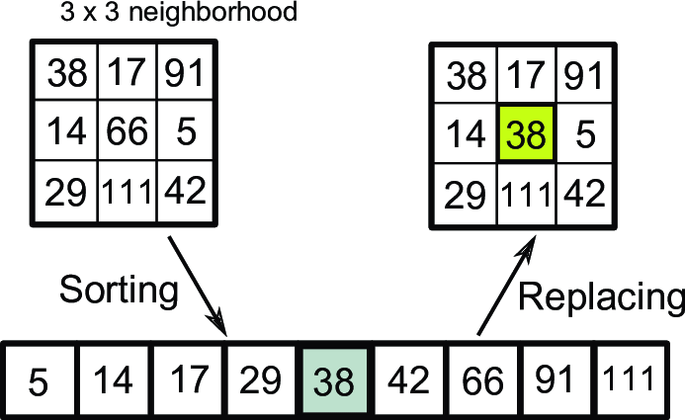
LMF vs AMF
Both of them are useful to remove impulsive noise (salt and pepper) from images
3x3 LMF
source:Marturi, N. (2013). Vision and visual servoing for nanomanipulation
and nanocharacterization in scanning electron microscope
(Doctoral dissertation, Université de Franche-Comté).
AMF Algorithm:
Initialize a filter kernel W of NxN size (N = 3)
Get MIN, MAX, CENTER, and MED of W
If (MED > MIN AND MED < MAX):
If (CENTER > MIN AND CENTER < MAX):
No change
Else:
CENTER ← MED
Else:
N ← N + 2
If (N <= N_{MAX}): (N_{MAX} = 15)
Go to Step 2
Else:
CENTER ← MED
‹#›/22

Slide 4
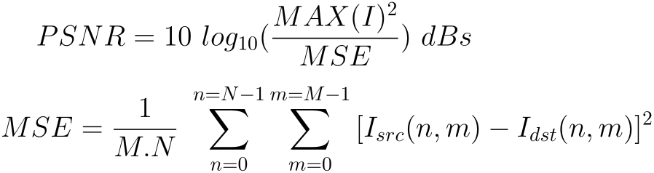
Images Dataset
Image Name | Resolution | PSNR (dBs)
low_noisy_0801 | 1356x2040 | 12.57
low_noisy_0802 | 1356x2040 | 12.15
low_noisy_0803 | 1536x2040 | 12.93
low_noisy_0804 | 1200x2040 | 12.52
low_noisy_0805 | 1536x2040 | 12.41
high_noisy_0801 | 1356x2040 | 7.09
high_noisy_0802 | 1356x2040 | 6.28
high_noisy_0803 | 1536x2040 | 7.41
high_noisy_0804 | 1200x2040 | 7.19
high_noisy_0805 | 1536x2040 | 7.12
M: total number of image rows
N: total number of image columns
MAX (I) = 255 for 8-bit images
Quality categories according to PSNR values (dBs):
<10 → Very Bad
10-20 → Bad
20 -25 → Poor
25-31 → Fair
31-37 → Good
> 37 → Excellent
‹#›/22

Slide 5
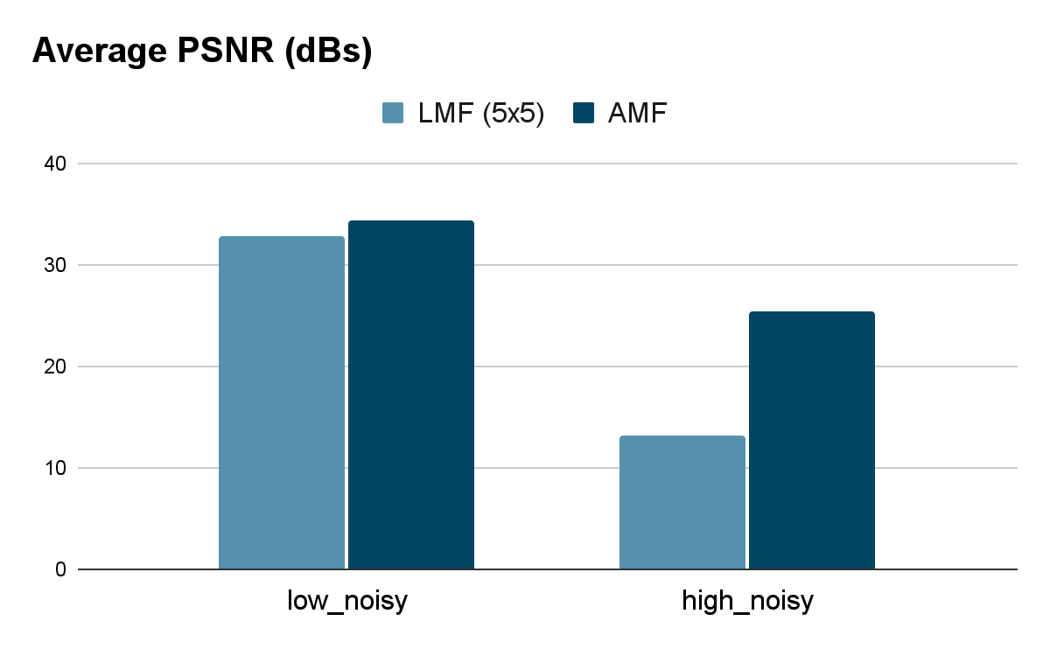
LMF vs AMF (Quality Performance)
‹#›/22

Slide 6
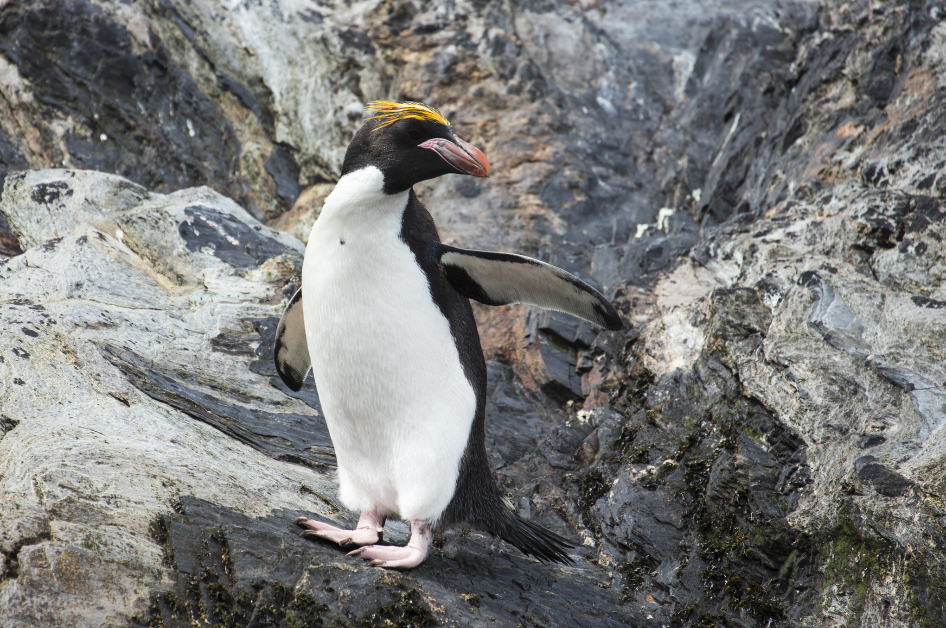
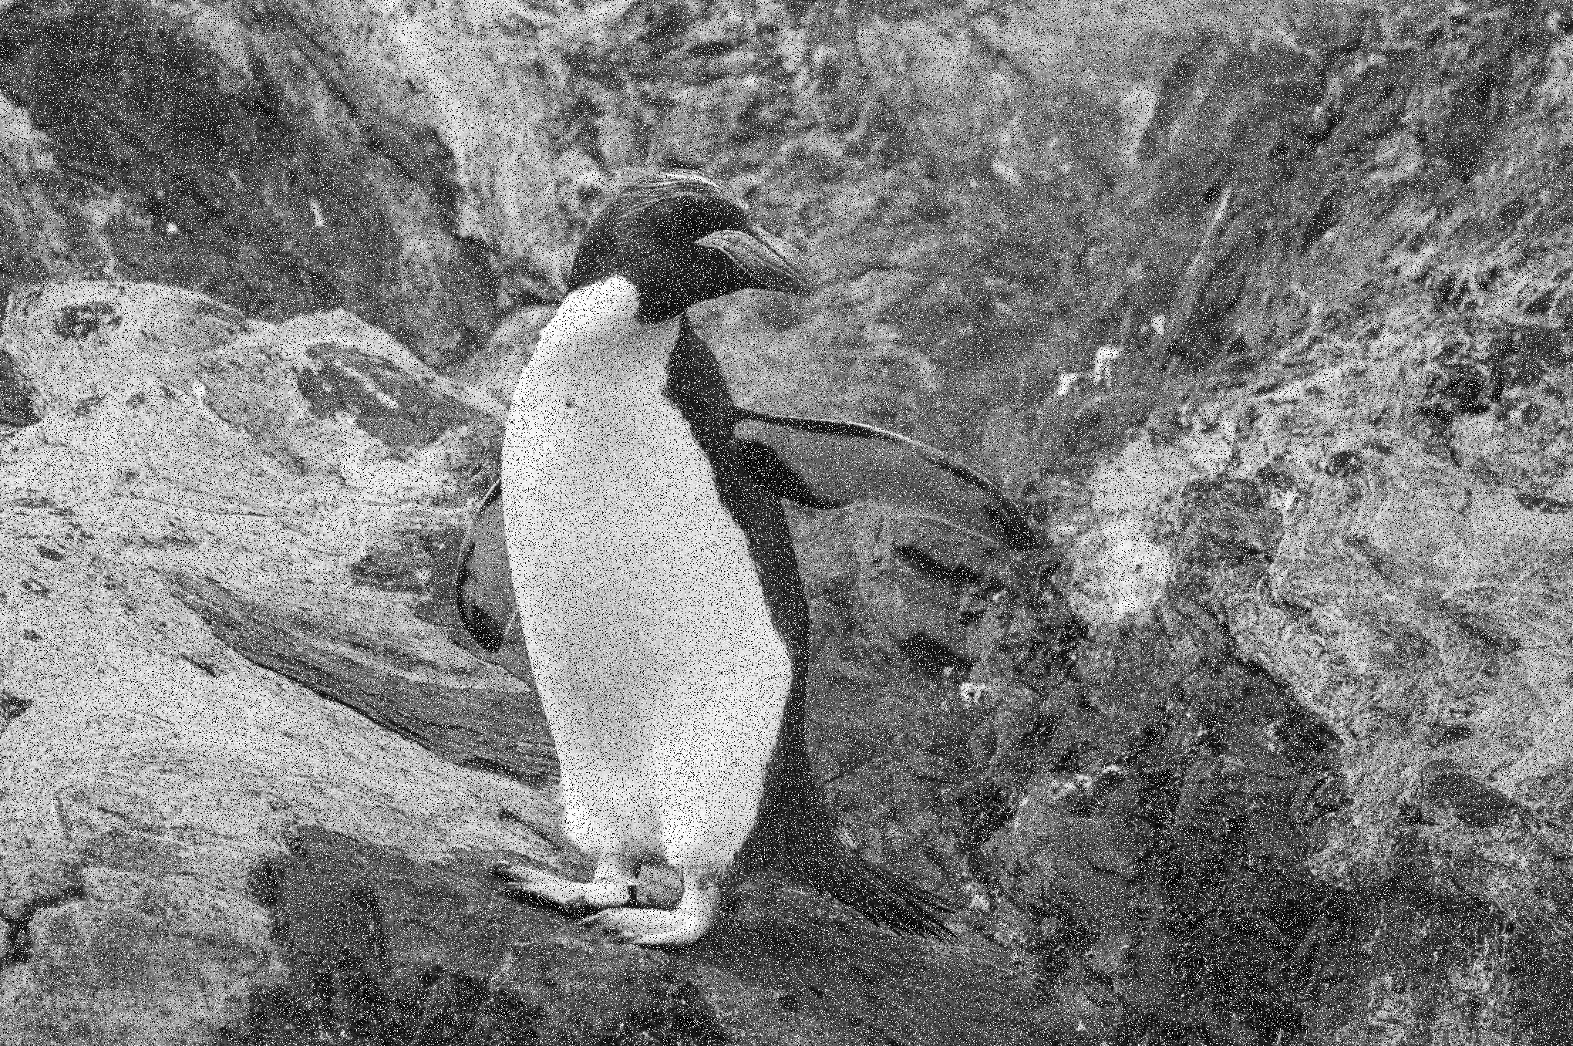
LMF vs AMF (Quality Performance)
(Original RGB Image) (Low Noisy Grayscale Image )
‹#›/22

Slide 7


LMF vs AMF (Quality Performance)
(Low Noisy Image After 5x5 LMF) (Low Noisy Image After AMF)
‹#›/22

Slide 8
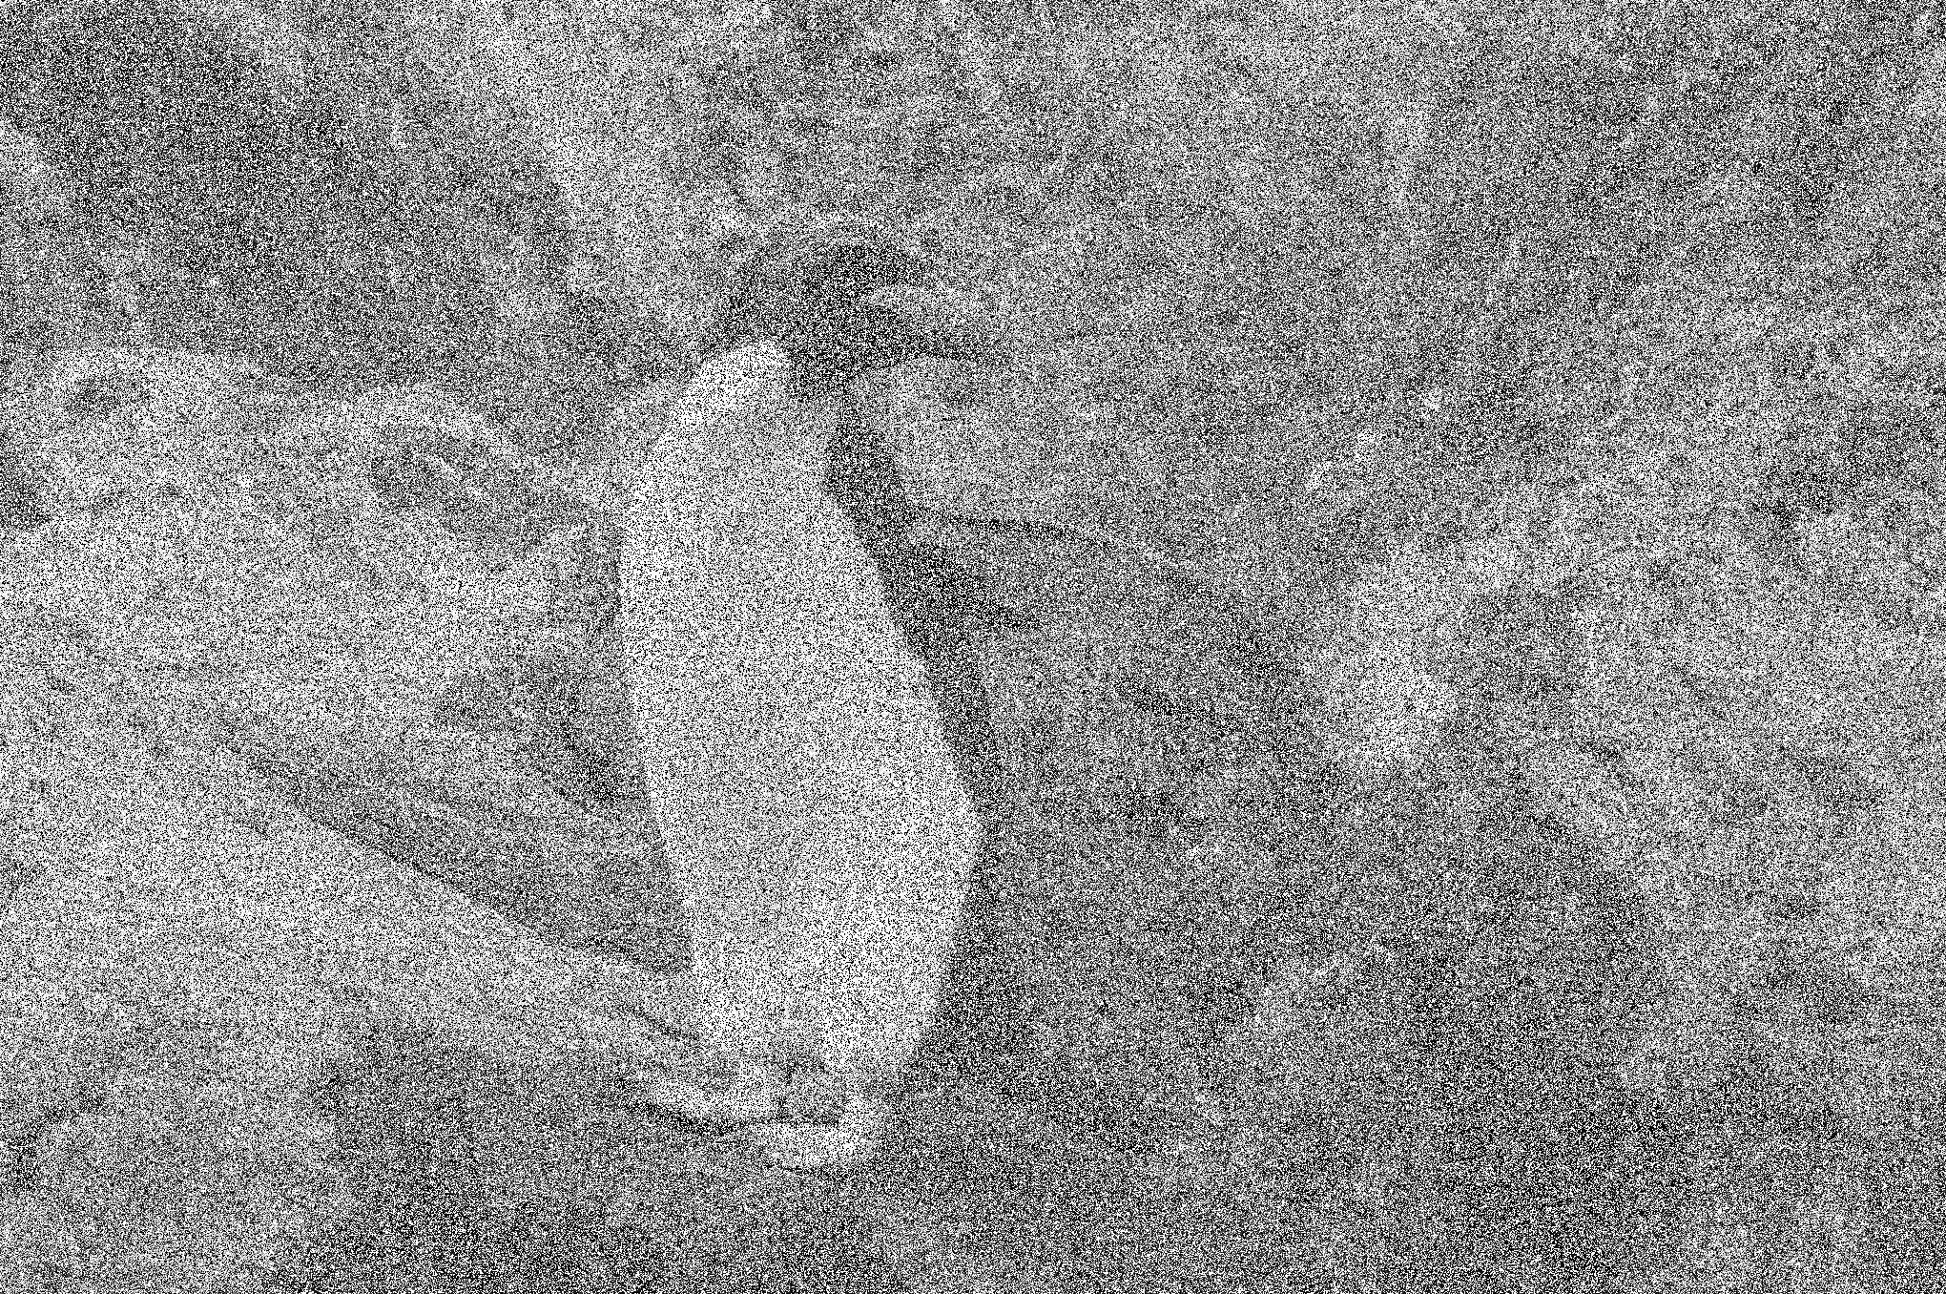
LMF vs AMF (Quality Performance)
(High Noisy Image)
‹#›/22

Slide 9
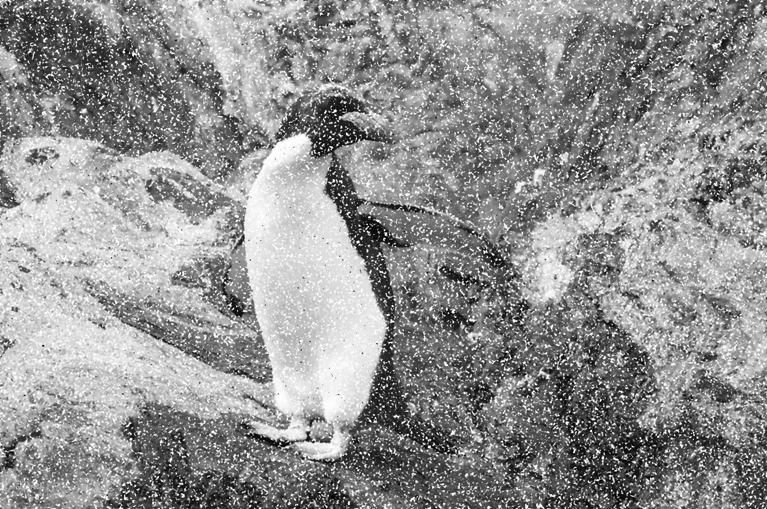
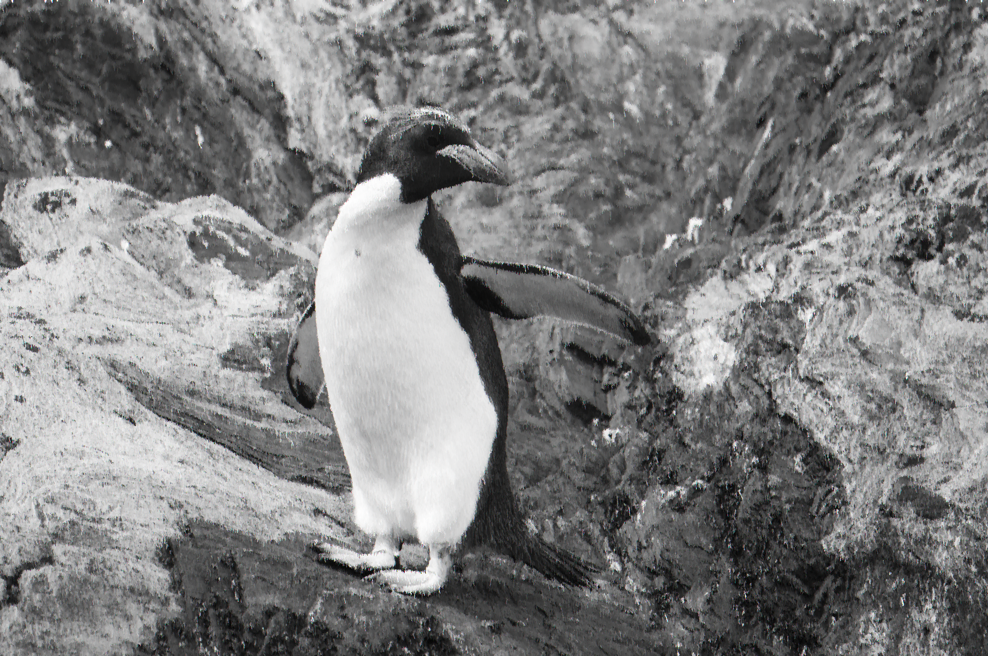
LMF vs AMF (Quality Performance)
(High Noisy Image After 5x5 LMF) (High Noisy Image After AMF)
‹#›/22

Slide 10
Basic Parallelization
Divide the image into partitions
Create a thread for each partition
Wait for all threads
Exit
‹#›/22

Slide 11


Basic Parallelization
Partition 0
Thread 0
Partition 1
Thread 1
Partition 2
Thread 2
Partition 3
Thread 3
‹#›/22

Slide 12
Scheduling
Divide the image into partitions
Create a number of threads
Threads will go through partitions
Exit when the assigned partitions are complete
‹#›/22

Slide 13
Scheduling
Partition 0
Thread 0
Partition 1
Thread 1
Partition 2
Thread 0
Partition 3
Thread 1
‹#›/22

Slide 14
Dynamic Scheduling
Threads will get initial partitions
Thread will finish its job
Thread will get the next ready partition
Exit when there are no more partitions
‹#›/22

Slide 15
Dynamic Scheduling
Partition 0
Thread 0
Partition 1
Thread 1
Partition 2
.
Partition 3
.
‹#›/22

Slide 16
Dynamic Scheduling
Fetch
DEQUEUE
Partition k
Work
Partition k+1
Partition k+2
…
Thread
Queue
‹#›/22

Slide 17
Dynamic Scheduling
k
k+1
k+2
k+3
Thread 0 fetches partition k.
Thread 1 fetches partition k+1.
Thread 2 fetches partition k+2.
Queue
Thread 0
Thread 1
Thread 2
‹#›/22

Slide 18
Dynamic Scheduling
k
k+1
k+2
k+3
Thread 0 fetches partition k.
Thread 1 fetches partition k+1.
Thread 2 fetches partition k+2.
Thread 1 finishes.
Thread 1 fetches partition k+3.
Queue
Thread 0
Thread 1
Thread 2
‹#›/22

Slide 19
Dynamic Scheduling
k
k+1
k+2
k+3
Thread 0: fetches partition k.
Thread 1: fetches partition k+1.
Thread 2: fetches partition k+2.
Thread 1: finishes.
Thread 1: fetches partition k+3.
Thread 0: finishes.
Thread 0: queue is empty.
Thread 0: returns.
Queue
Thread 0
Thread 1
Thread 2
‹#›/22

Slide 20
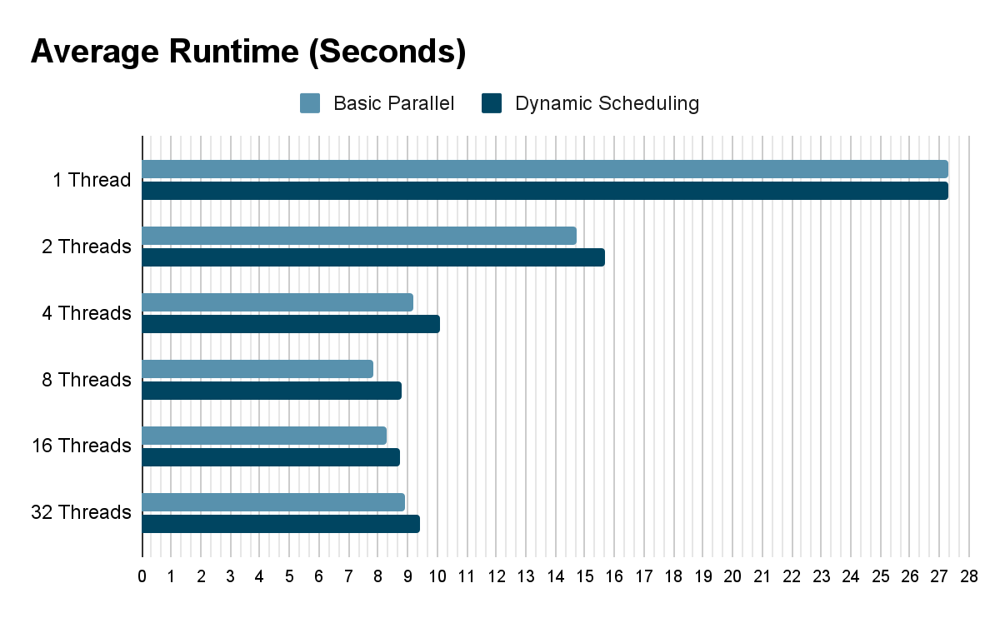
Runtime Results
‹#›/22

Slide 21
Memory Related Results
16 Threads | Basic Parallelization | Dynamic Scheduling | Difference
Memory Consumption | 71.3 MB | 71.0 MB | 360.1 KB
Number of Allocations | 1,506,613 | 1,500,705 | 5,908
32 Threads | Basic Parallelization | Dynamic Scheduling | Difference
Memory Consumption | 78.5 MB | 78.1 MB | 440 KB
Number of Allocations | 1,619,690 | 1,612,705 | 6,985
64 Threads | Basic Parallelization | Dynamic Scheduling | Difference
Memory Consumption | 93.3 MB | 92.7 MB | 541.0 KB
Number of Allocations | 1,849,557 | 1,841,650 | 7,907
‹#›/22

Slide 22
Conclusions
The average runtime of a 5x5 LMF with OpenCV (uses multithreading) is < 30 ms
Applying LMF sequentially and with higher window sizes can also be tested
The average runtime of a sequential AMF (3x3 → 15x15) ≈ 27 seconds
On a 4-core hardware with 8 threads: an approximate 74% reduction of runtime is achieved using multithreading
‹#›/22

